Slide 1

Foundational Skills Program
Course Title: Software Testing
Date: April 19, 2026
Md. Golam Mostofa
AI/ML-QA Engineer, Bizzntek Ltd

Slide 2
Outline
Evaluators and reflect-refine loops
Introducing Mistral LLM
Mistral API using
Evaluation Setup
Environment Setup
AI-Driven Automated Testing of EDGE Chatbot

Slide 3
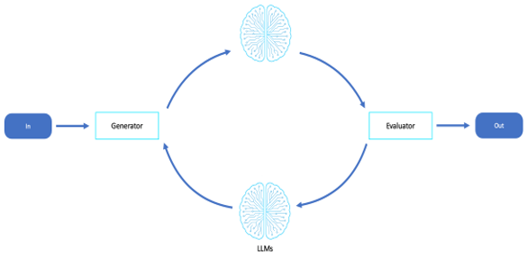
Evaluators and reflect-refine loops
Evaluator-optimizer workflows use two LLM stages: one generates the response, and another evaluates its quality.
The evaluator checks whether the generated output meets predefined success criteria.
These workflows are effective for tasks that require refinement and multiple iterations.
This approach enables autonomous quality assurance for LLM-based systems and chatbots.
Common use cases
Red-team agents compared to blue-team agents
Agents that generate, evaluate, and revise code or plans
Quality assurance, hallucination detection, and style enforcement
Source: Agentic AI patterns and workflows on AWS - AWS Prescriptive Guidance

Slide 4


Introducing Mistral LLM
What is Mistral AI?
Mistral AI is a France-based AI company focused on building open and efficient Large Language Models (LLMs).
Popular Mistral models
Mistral emphasizes
Mistral 7B: lightweight and efficient open-weight LLM
Mixtral 8x7B: Mixture-of-Experts (MoE) model for improved scalability
Mistral Large: flagship model for advanced reasoning and enterprise tasks
Codestral: optimized for coding and software development
Le Chat: conversational AI assistant similar to ChatGPT
Open-source and open-weight AI models
Multilingual support
Efficient deployment on smaller hardware
Privacy-focused and on-premise AI solutions

Slide 5
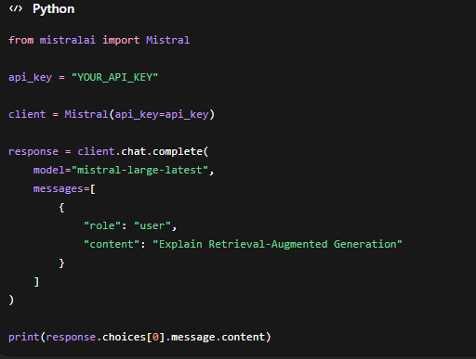
Mistral API using
Steps to Use the Mistral API
Create an account on Mistral AI Platform
Generate an API key from the developer console
Install the official SDK or use HTTP requests
Send prompts to supported models such as:
Mistral 7B
Mixtral 8x7B
Mistral Large
Codestral

Slide 6
EDEG Chatbot Test automation Architecture
Start from main function
Checking test file available or not
Result folder checking
Launch app in Chrome browser
Wait for ready
Put prompt into the chatbot
Get response
Test response by the Mistral LLM
Same test result

Slide 7
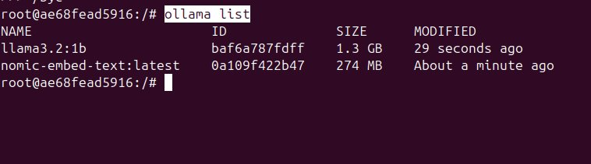




Pre-Requisites
Key Features
Ollama install
Chrome-browser
Llama3.2:1b
Nomic-embed-text

Slide 8

Environment Setup For EDEG Chatbot
1
Create Virtual Environment & Active
2
Install Requirements
python –m venv venv
venv\Scripts\activate
pip install –r requirements.txt
Download the EDEG Chatbot first
Install the Python packages.
3
Run the Chatbot
4
Test the Chatbot
streamlit run app.py
venv\Scripts\activate
python fill_test_sheet.py
Navigate: http://localhost:8501/
Run the test.

Slide 9
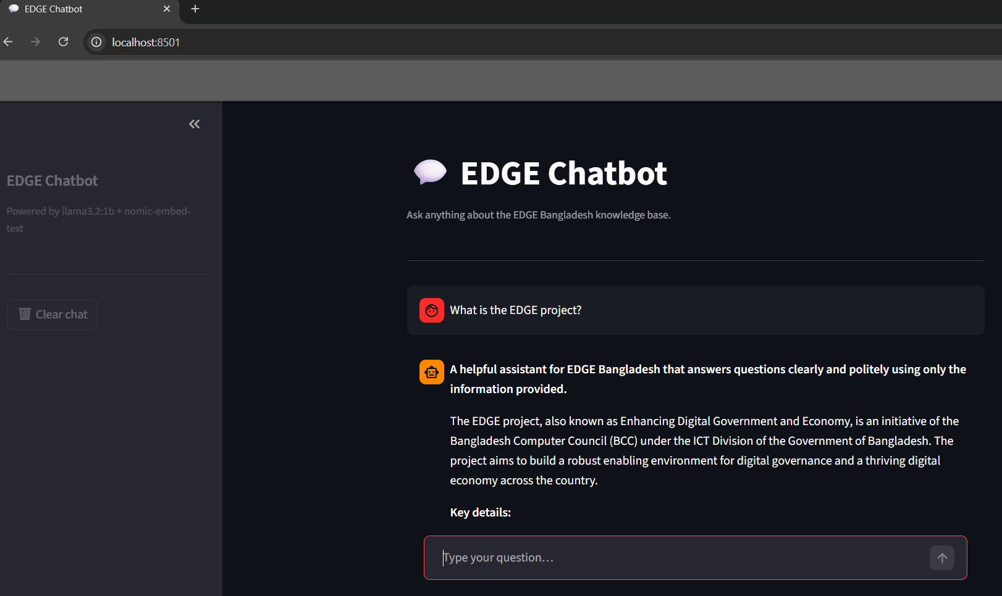
Test EDGE Chatbot Automatically

Slide 10
Q&A
Any Questions?

Slide 11
Thanks
Md. Golam Mostofa
golam.mostofa@bizzntek.com

